Slide 1
What does it mean to be a Health for Life School?

Slide 2
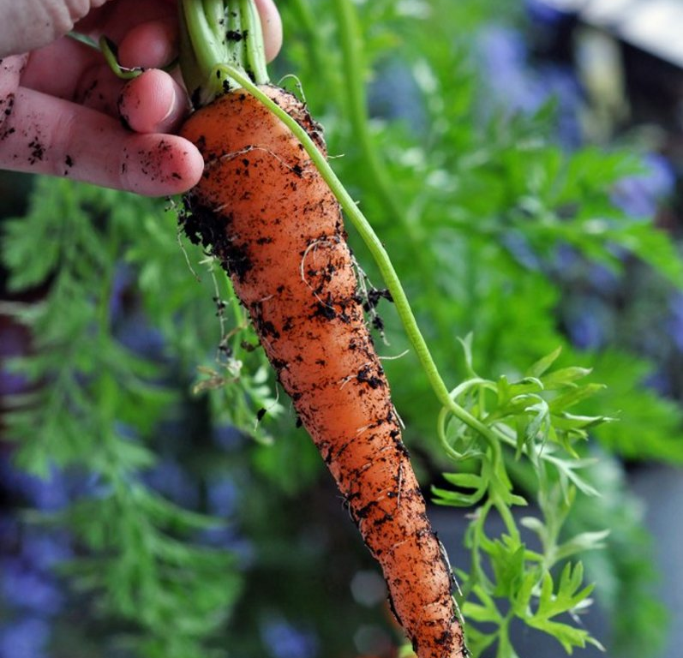
What will happen to our vegetables and fruit?
Cooking activities.
Heritage mornings.
Cooking workshops.

Slide 3
Cooking activities

Slide 4
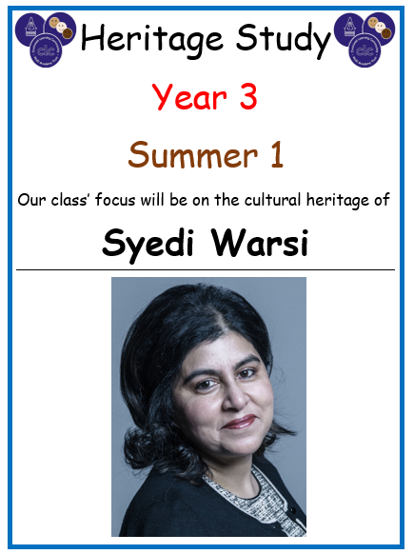
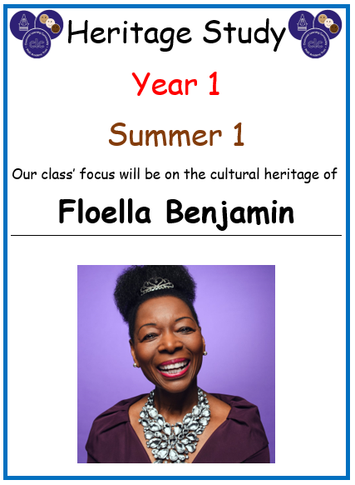
KS1 Heritage Mornings

Slide 5
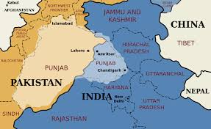
Heritage Mornings

Slide 6
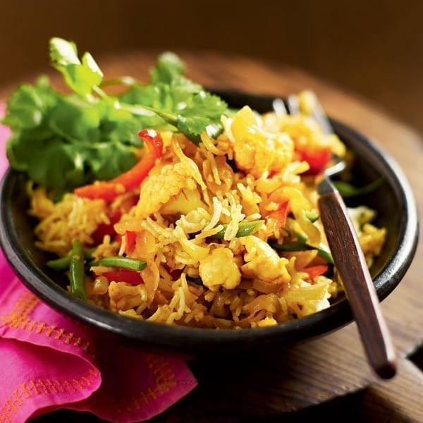
Vegetable Biryani Vegetable biryani recipe | delicious. magazine (deliciousmagazine.co.uk)
Ingredients
275g basmati rice
40g sunflower spread
1 large onion, finely sliced
2 garlic cloves, crushed
Thumb-size piece of fresh ginger, grated
½ tsp ground turmeric
1 tsp mild chilli powder
1 tsp ground coriander
500g mixed vegetables, prepared and cut into small pieces (we used cauliflower, red pepper, green beans and mushrooms)
6 cardamom pods, cracked
6 cloves
Small handful fresh coriander, to garnish

Slide 7
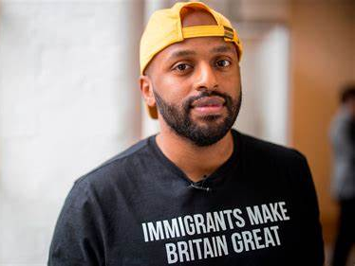
Year 4 Heritage Morning Magid Magid

Slide 8
Muufo Muufo Somali bread (mysomalifood.com)
Ingredients
Ingredients
1 cup cornmeal (precooked, "PAN")
1 cup plain flour
1 teaspoon baking powder
2 teaspoons sugar
1 teaspoon salt
1 tablespoon of oil, and more for cooking the muufo

Slide 9
Vegetable Biryani Vegetable biryani recipe | delicious. magazine (deliciousmagazine.co.uk)
Ingredients
275g basmati rice
40g sunflower spread
1 large onion, finely sliced
2 garlic cloves, crushed
Thumb-size piece of fresh ginger, grated
½ tsp ground turmeric
1 tsp mild chilli powder
1 tsp ground coriander
500g mixed vegetables, prepared and cut into small pieces (we used cauliflower, red pepper, green beans and mushrooms)
6 cardamom pods, cracked
6 cloves
Small handful fresh coriander, to garnish

Slide 10
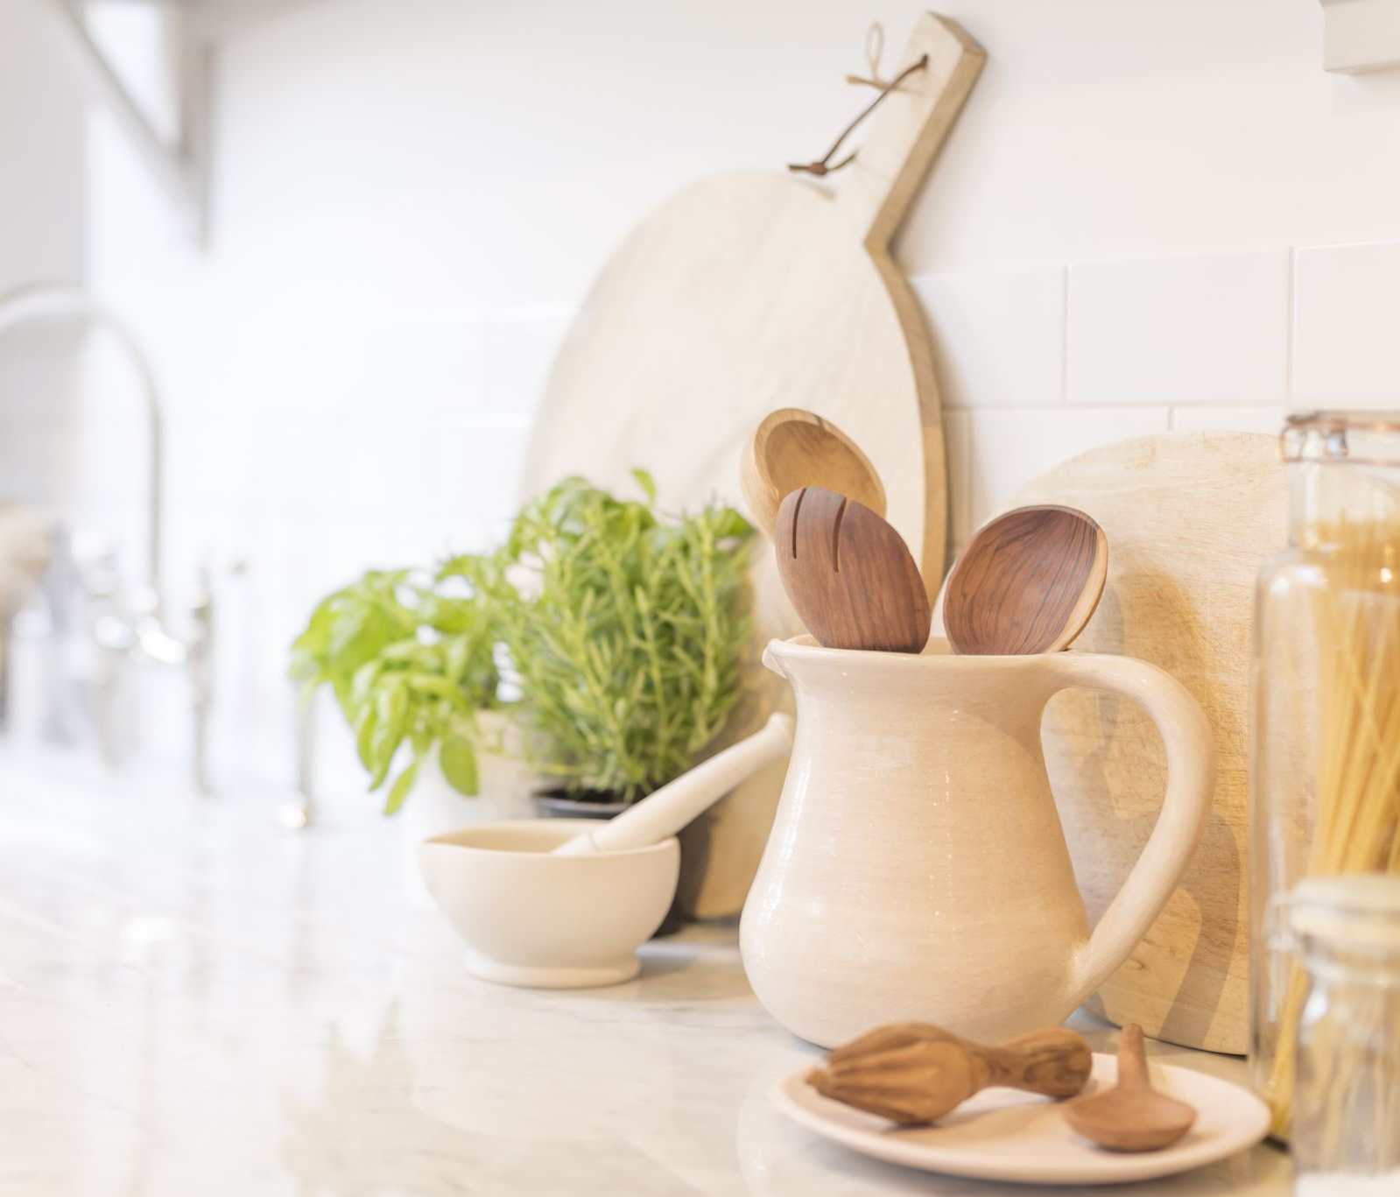
Cooking Workshops
Look out for your invitation.

Slide 11
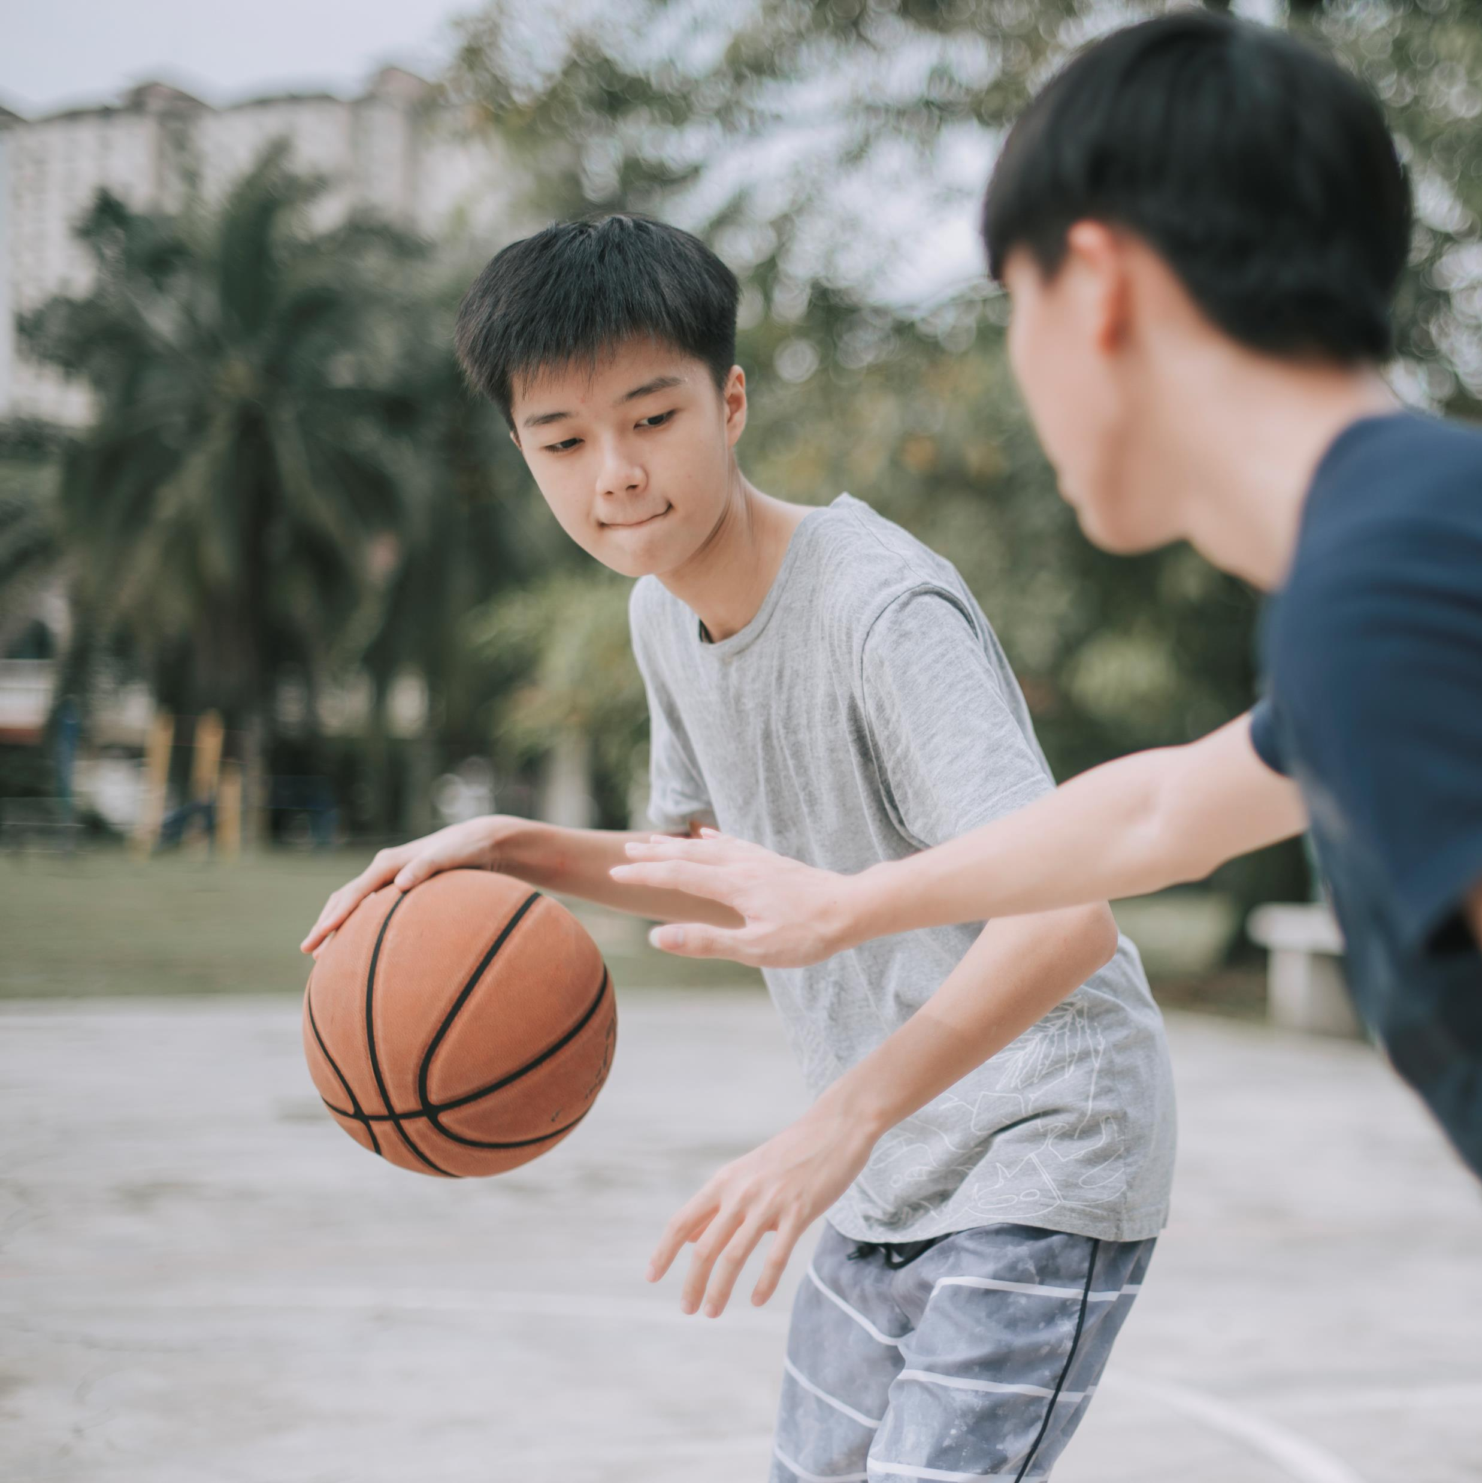
Basketball Club Monday afternoons.

Slide 12
Gardening Club Tuesday afternoons.

Slide 13
Would you like to be a Health for Life Representative?
Show visitors our gardens.
Tell them about our fun and exciting activities that promote health.
Ask your class for feedback and ideas.

Slide 14
Growing competition biggest vegetable wins a prize.

Slide 15
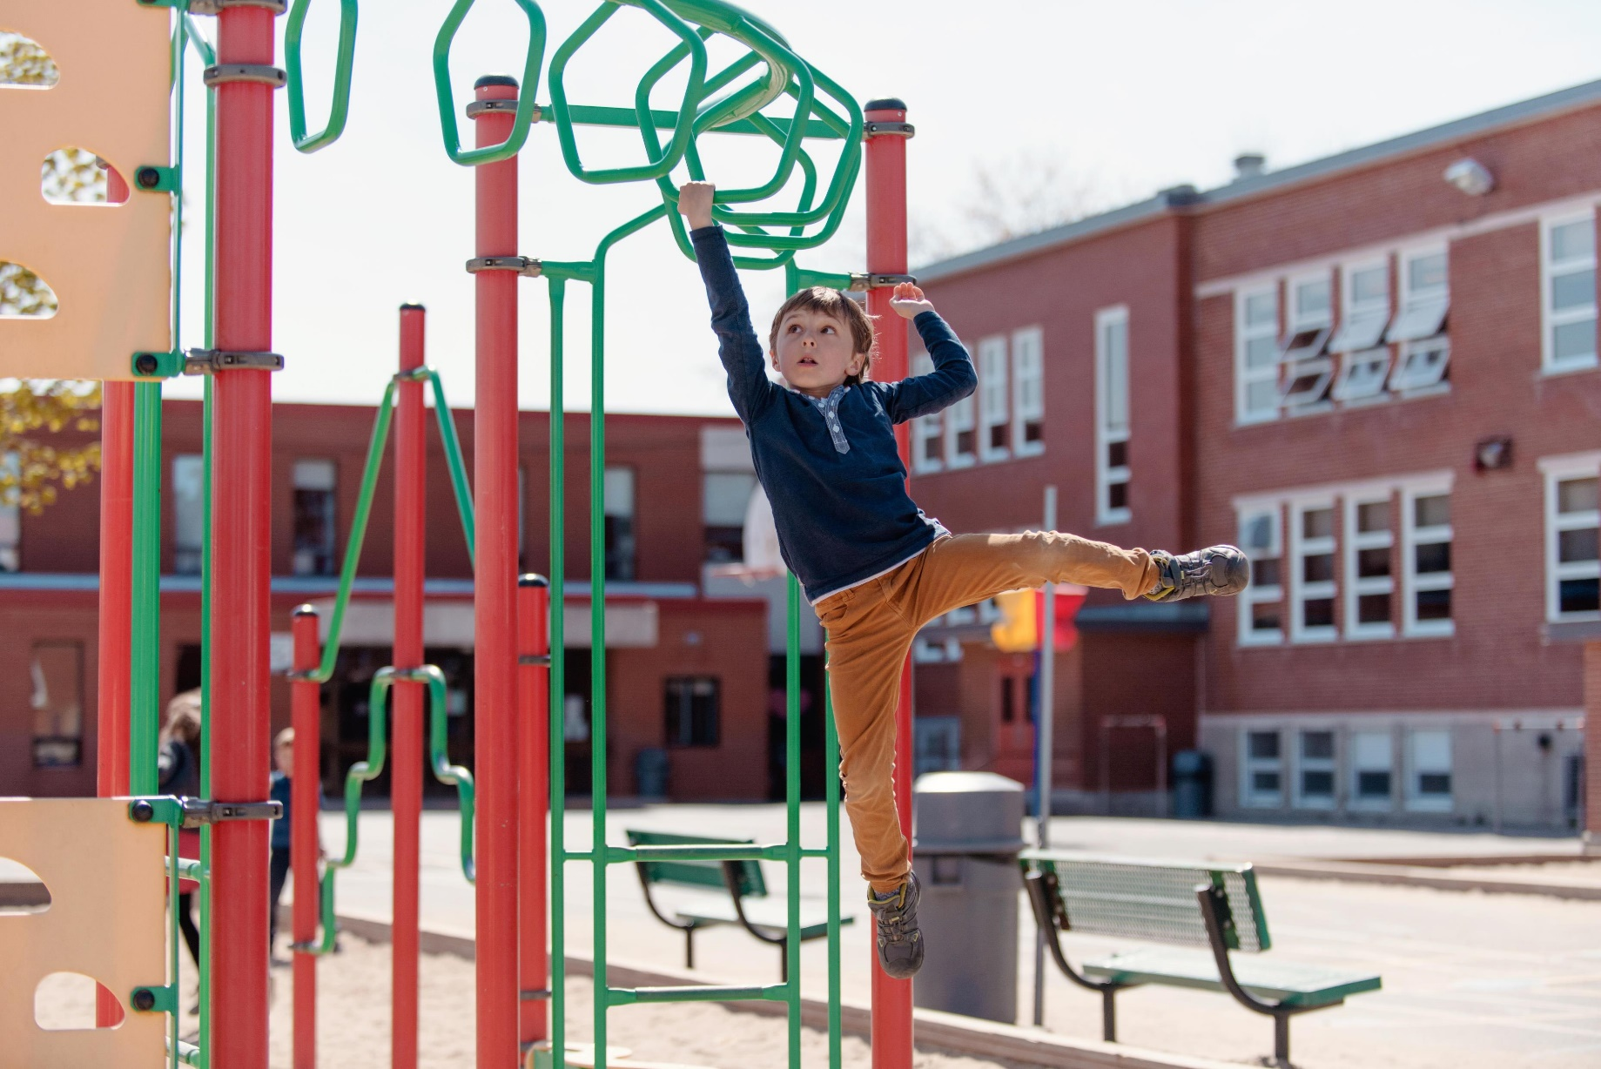
Bordesley Village Play Leaders
Plan fun activities for playtime.
Lead games during play.
Be a Health for Life ambassador.
Take care of plants and teach others.

